Slide 1
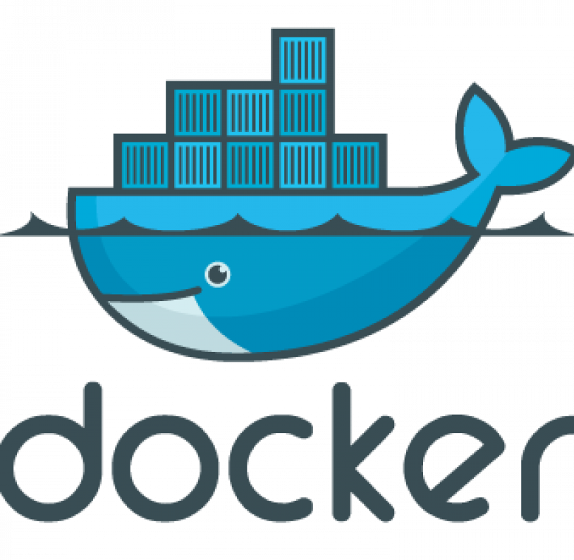
Introduction to Docker
How to use Docker for DevOps

Slide 2
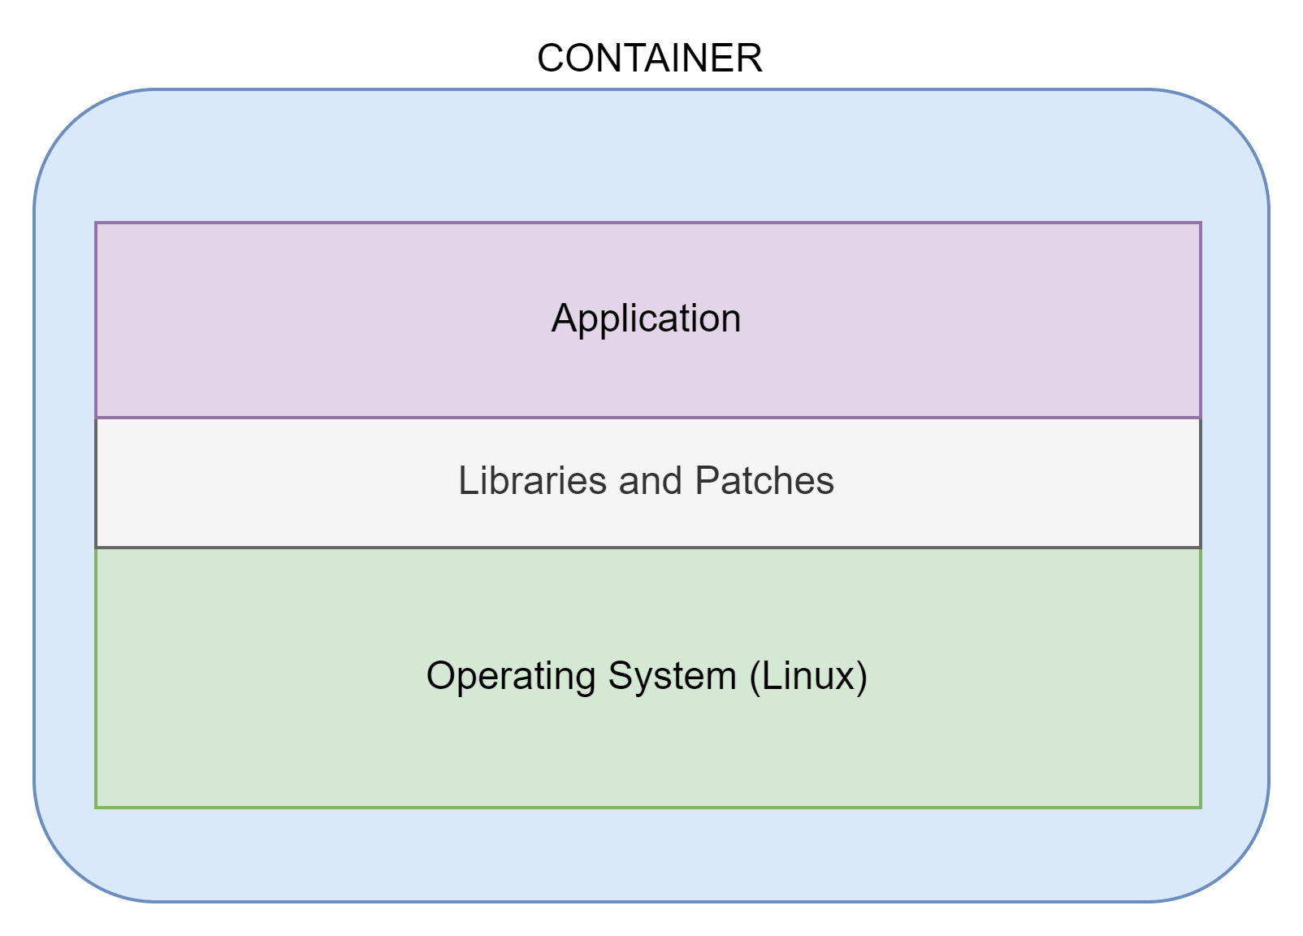
What is a Container
Docker is a 'Container' based environment.
A Container is a virtual server, it contains:
  An Operating System (usually Linux)
  Any required Libraries and patches
  Specific Application Software

Slide 3
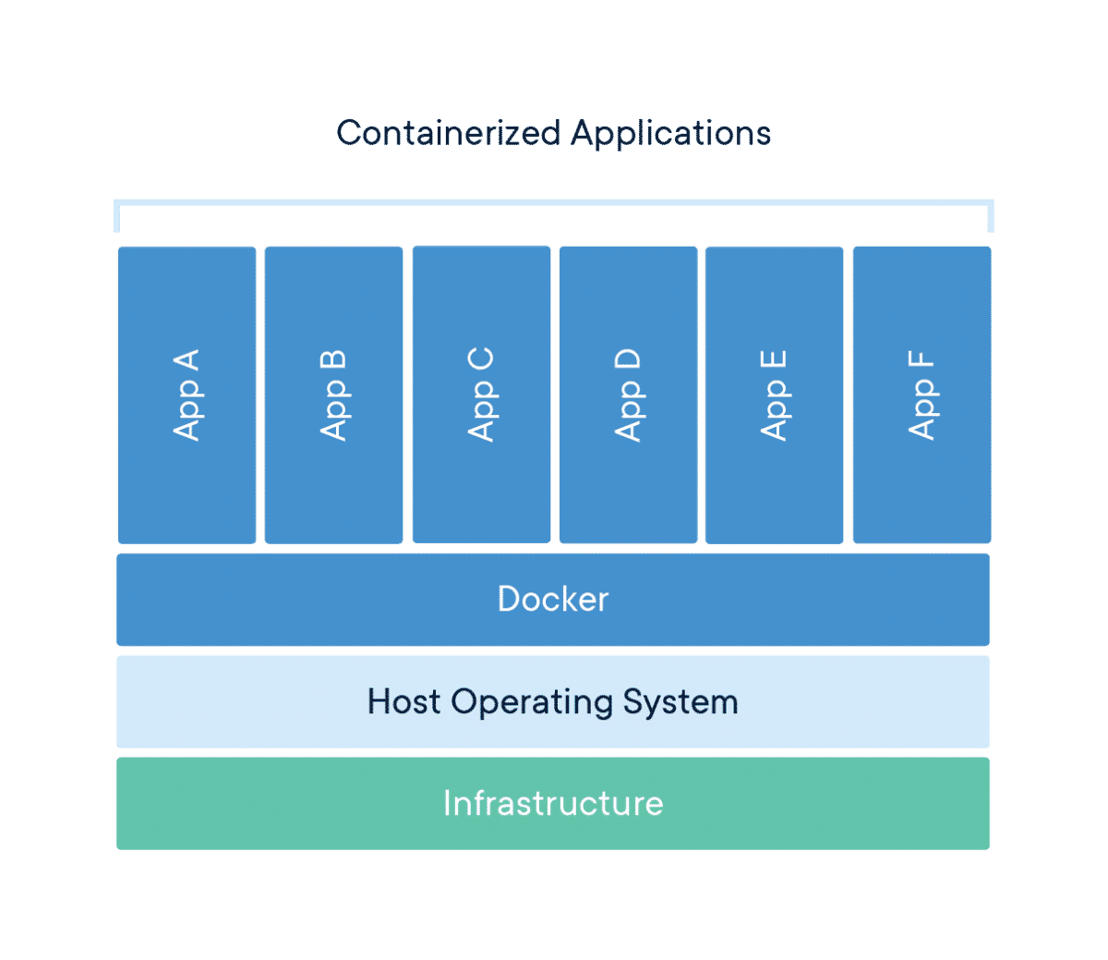
What is Docker
Docker is an environment that runs multiple containers.
This means Docker can runs lots of 'virtual machines' on one host system.

Slide 4
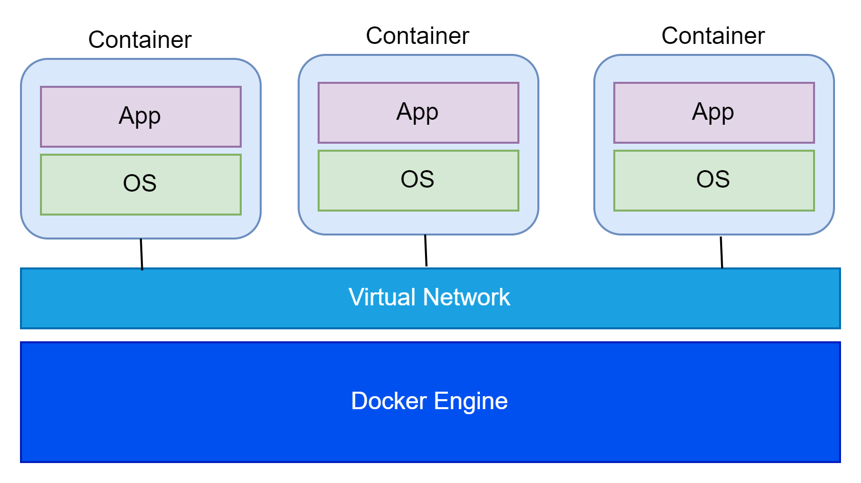
Docker Network
Docker also provides a virtual network, so all containers can connect to each other.
Docker can support multiple networks.
Docker can also connect containers in different Docker systems, called an Overlay Network.

Slide 5
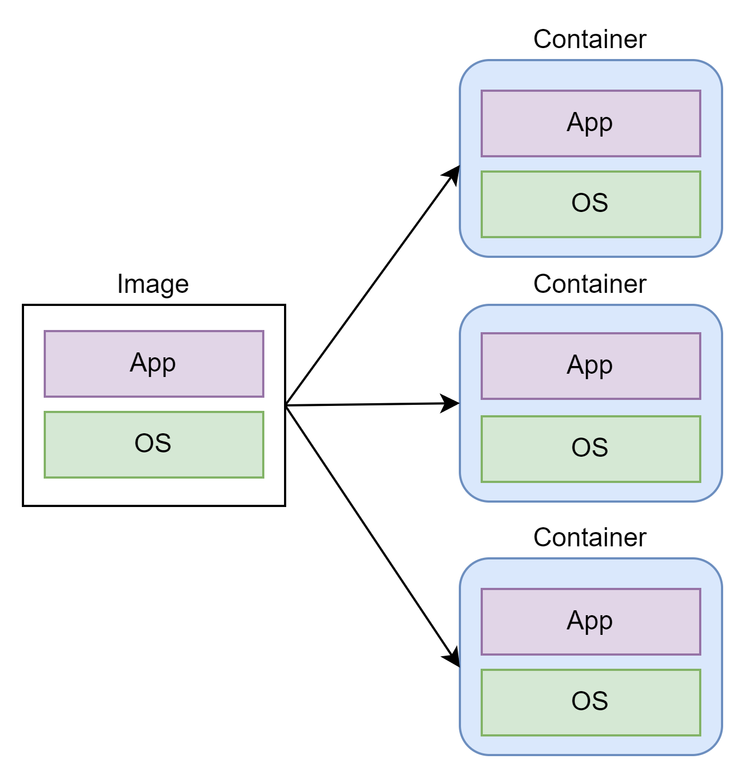
Docker Images
To create a Container, we first create an Image.
An Image is like a template for the container.
It contains all the software (OS, libraries, app etc.), but it is not running.
You can then start Containers using the image, so containers start with everything ready to run.
You can run as many copies of the image as you need.

Slide 6
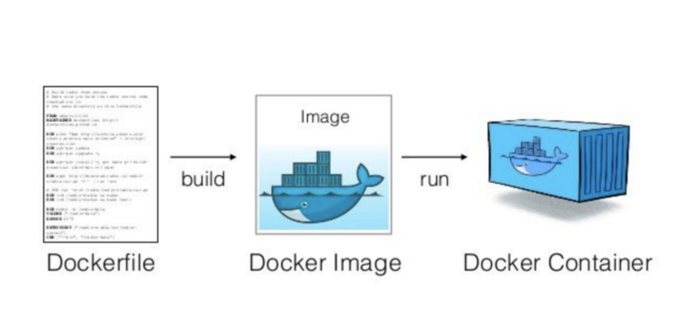
How to Define Docker Images
We create container Images with a file called a Dockerfile.
We start with an existing image and specify the additional software we need to install, and any other configuration changes we want to make in the OS.
We run the Dockerfile to build the image.

Slide 7
Available Docker Images
Docker allows Images to be stored in a Repository. You can run your own repository but companies also run public repositories.
One of the largest public repositories is run by the Docker organisation and is available at: DockerHub.com
One of the very powerful features of Docker is there are many Docker Images ready to download.
This contains thousands of images with software already installed and configured, ready to run as a 'service' in your application.

Slide 8
Example of a Dockerfile
We create our own Dockerfile so we can modify an existing Docker image and add what we need.
Reasons for doing this are:
  Install our own software
  Install libraries needed for our own software
  Install third party applications
  Make configuration changes to installed software or the Operating System of an existing image.
The objective is to create an Image which can start without any manual intervention.

Slide 9
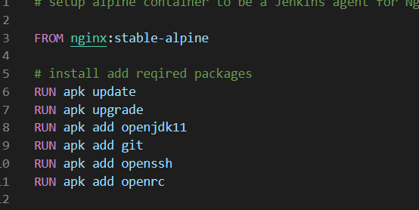
Example Dockerfile
This Dockerfile takes an Nginx image and installs java and git.
You can store the image with a name of your choice and then start a container using this image.
When the container starts it will have Nginx, java and git already installed.

Slide 10
Docker Compose
Docker Images and containers can be built individually, using command line tools.
However, this can become tedious when we need to start multiple containers every time we want to start our application.
To prevent this, Docker has a scripting language which allows us to define our environment once and then run it as a single command.
This tool is called Docker Compose. We will use this to start and stop our environment in the lab.

Slide 11
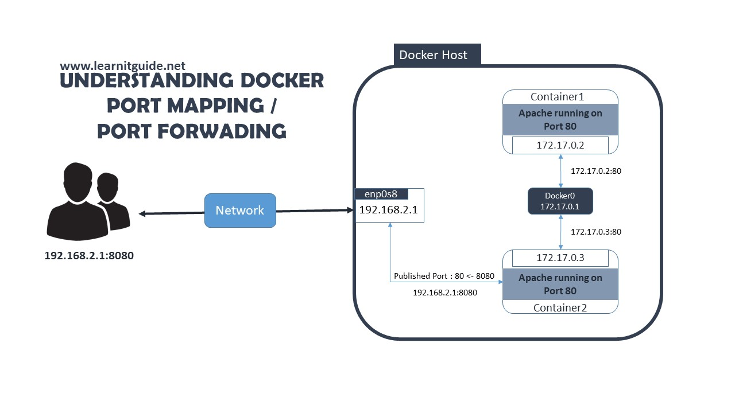
Accessing Docker Containers
So far, we have seen that Docker containers can talk to each other.
But at some stage we want them to talk to the outside world.
This may be:
  A browser front end
  Local applications on your laptop
  Other external systems
  The web
To do this we need to tell Docker to allow a port from a container to available to the outside world.
We can also map that to a different port, so containers using the same port internally can talk to different ports externally.

Slide 12
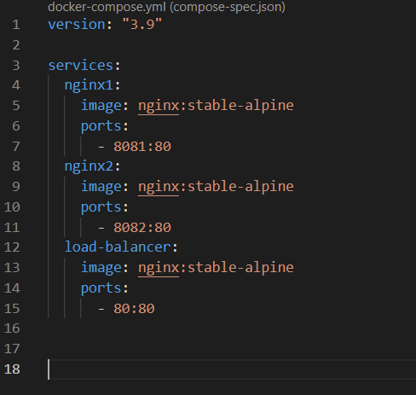
Example of a Docker Compose File
This docker compose file creates 3 Nginx containers.
The Nginx image is 'pulled' from the Docker respository.
The three container ports (which default to port 80) are mapped to 3 different ports, accessible outside Docker.

Slide 13
Accessing a Container
When we are developing our containers or when we want to examine them we need to connect directly.
We do this by running a shell which provides a command line to interact with the container, just like we had 'logged in' to the virtual server.
We can also access log files and other statistics for a container during runtime.
Docker provides a command line interface (CLI) to perform these commands.

Slide 14
Why are Containers so Useful
Containers are being used more and more widely. Some of the largest IT systems make heavy use of containers in their production environments, such as Netflix, Google, Facebook etc.
Containers have many advantages:
  They make deployment more reliable
  They automate the whole process of provisioning and deployment
  They can be made resilient and scalable
  They support different architecture patterns
  A large library of ready-made containers is available for download, which can be integrated like ready to run 'services'.
DevOps teams also make heavy use of containers for the tooling of environments, such as CI/CD pipelines and self-service tools.

Slide 15
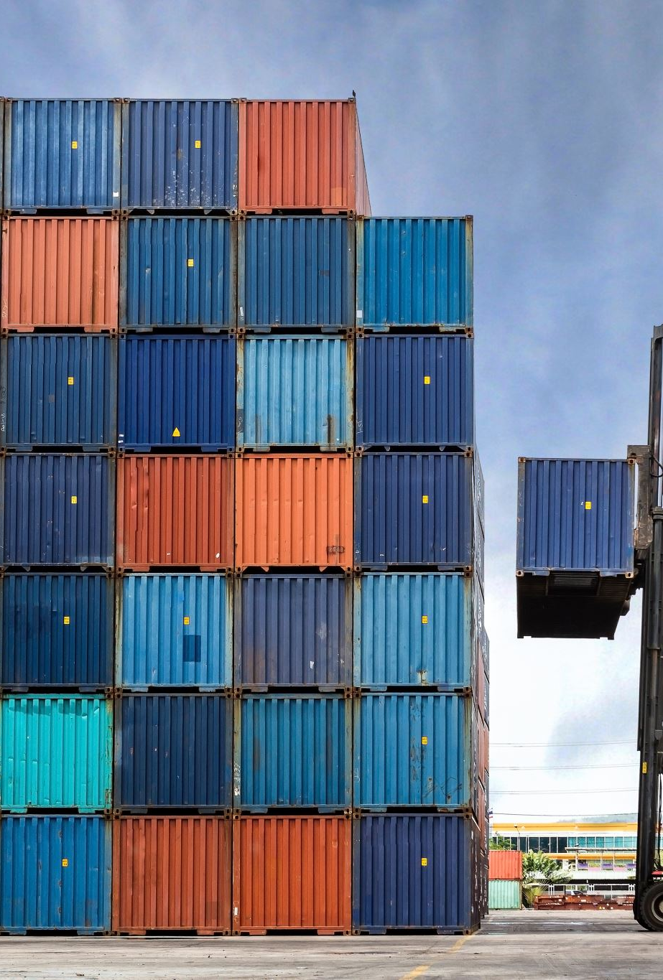
What is Container Orchestration
Containers can be easily scaled by simply starting more containers from an image.
Load balancers can be used to distribute load between similar containers.
In a microservices architecture (which is common for containers) we have containers provide just one service of an application. With this pattern we can end up with a lot of different types of containers.

Slide 16
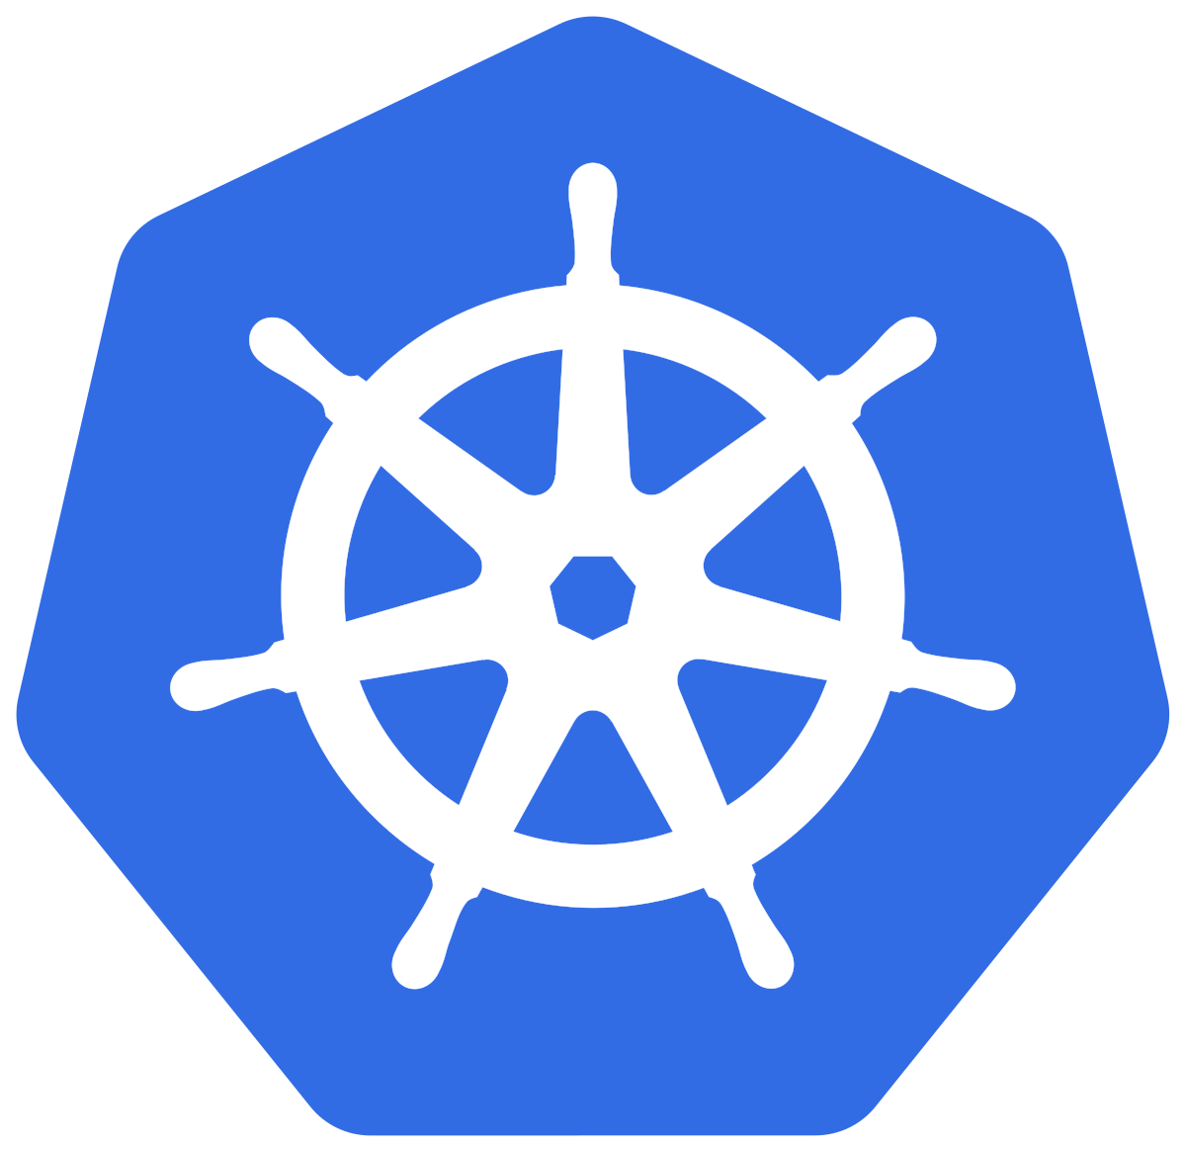
Container Orchestration
To make this effective at scale we add another layer on top of Containers which is responsible for:
  Starting and stopping all containers
  Load balancing between containers
  Can monitor and automate the process of starting and stopping containers.
Tools that provide this server are called Orchestrators. The most common used tools are:
  Kubernetes
  Swarm

